Slide 1

Life Expectancy
Exploring Health Factors and Trends

Slide 2
Introduction
Data source: Global Health Observatory (GHO) data repository under the World Health Organization (WHO).
Purpose of the dataset: Tracking health status and related factors for different countries.

Slide 3
Dataset Overview
Description of the dataset: Life expectancy and health factors for 193 countries.
Selection criteria: Critical factors chosen for analysis.
Timeframe: Data from 2000 to 2015 selected for analysis.
Total rows and columns in the dataset: 2938 rows and 22 columns.

Slide 4
Exploring Healthcare Indicators and Life Expectancy
Introduction: This study aims to analyze key healthcare indicators impacting life expectancy.
Objective: Survey life expectancy across countries, gauge indicators influencing it, and use Regression models for insights.
Methodology: Data analysis focuses on regression models to understand correlations.
Approach: Gather data on healthcare indicators, preprocess, develop models, and analyze.

Slide 5
Categories of Predicting Variables
Immunization related factors
Mortality factors
Economical factors
Social factors

Slide 6
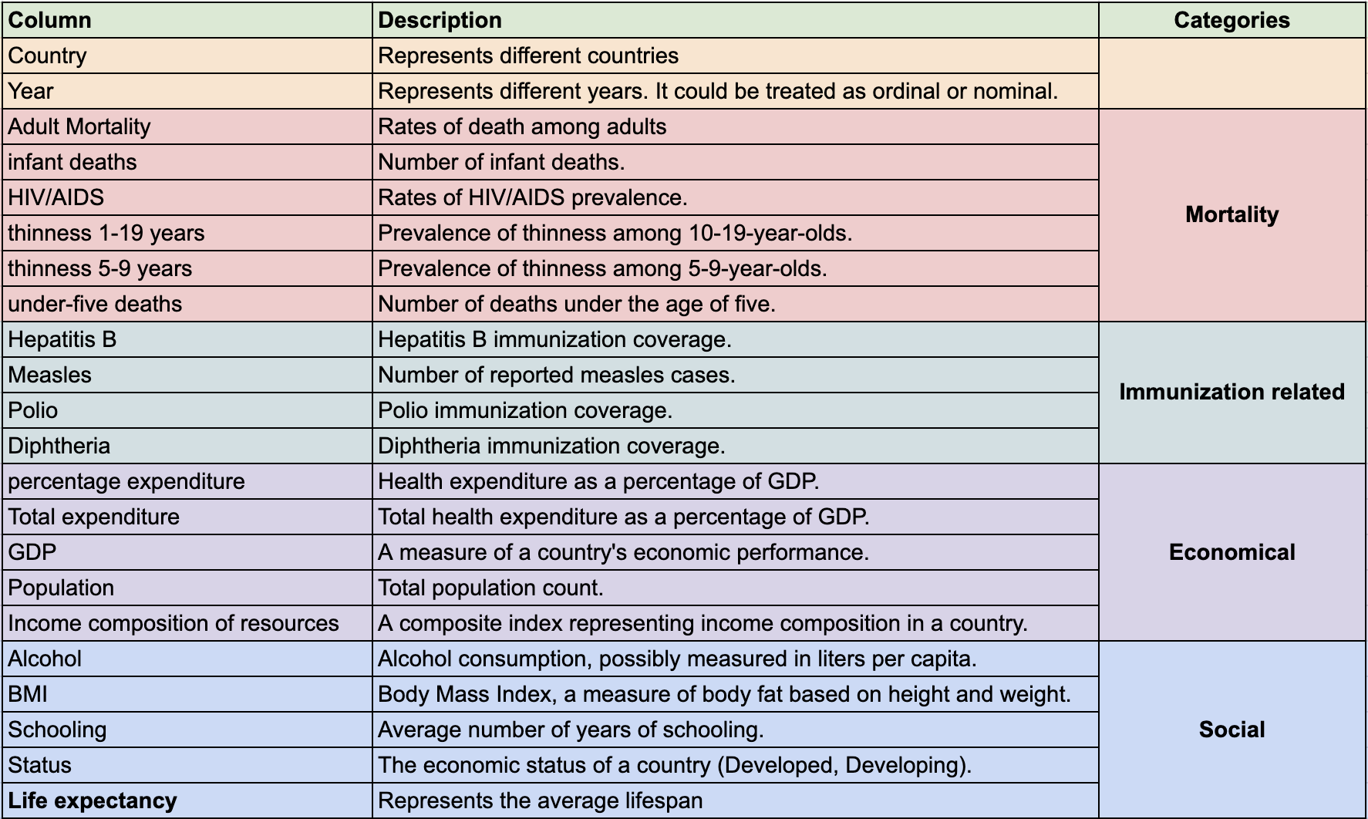
Features and Target

Slide 7
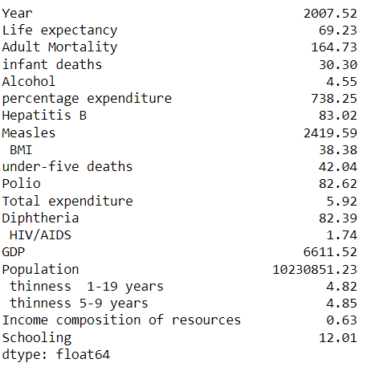
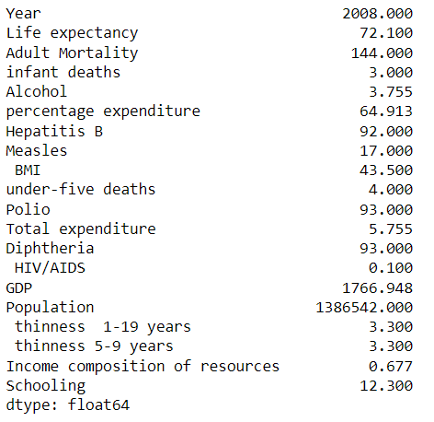
Mean Of Each Column
Median Of Each Column

Slide 8
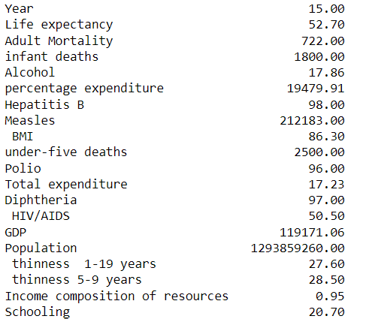
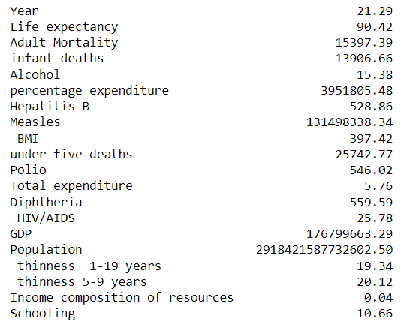
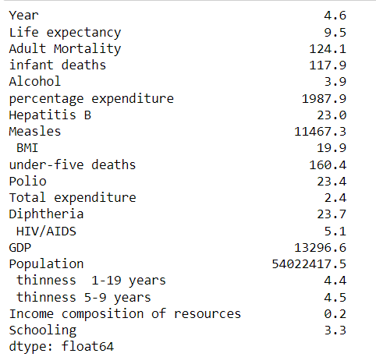
Range
Variance
Standard Deviation

Slide 9
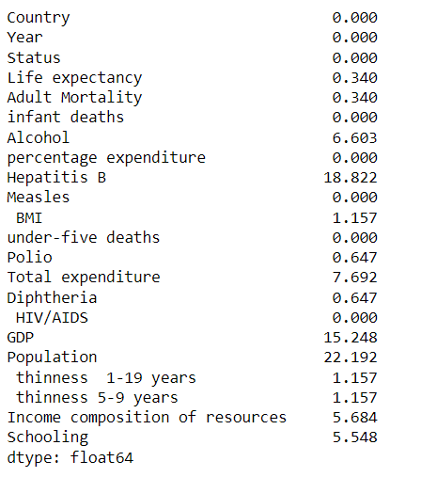
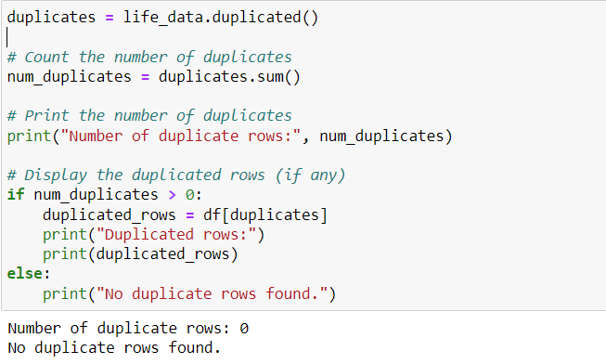
Percentage Of Missing Values
Duplicate Records in the data set

Slide 10
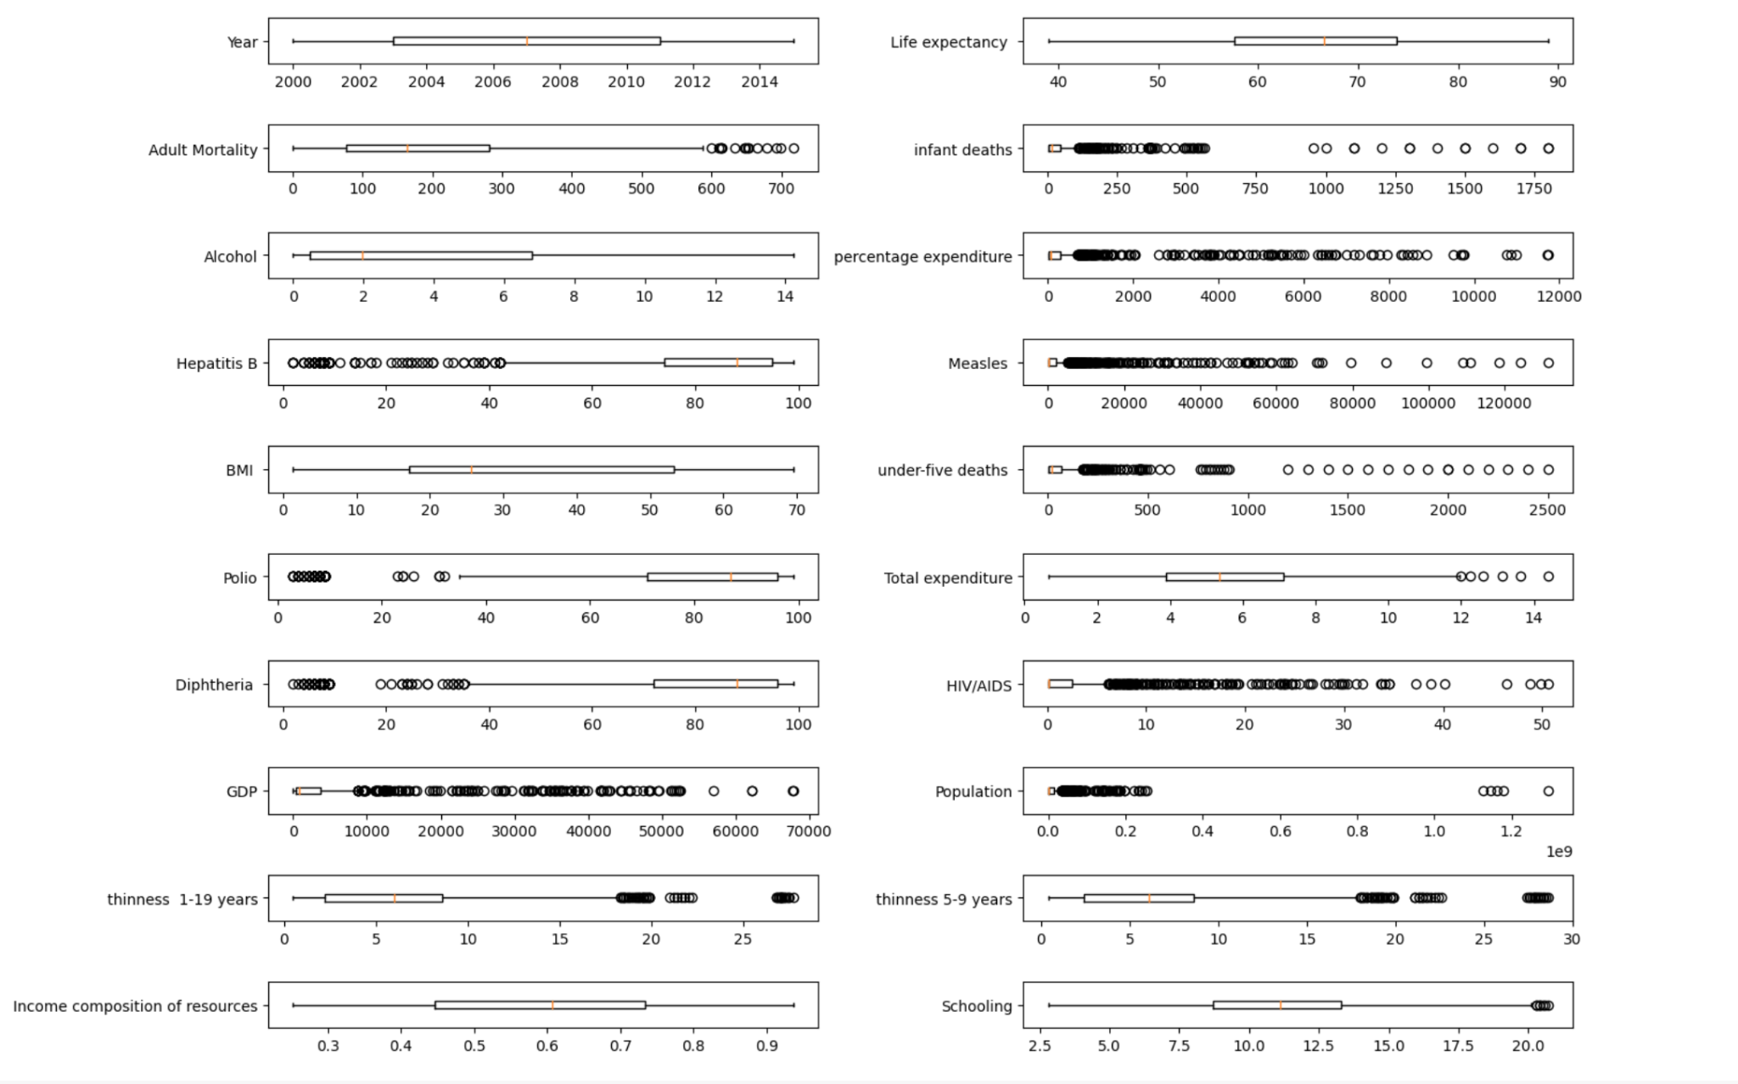
Outliers for Numerical data

Slide 11
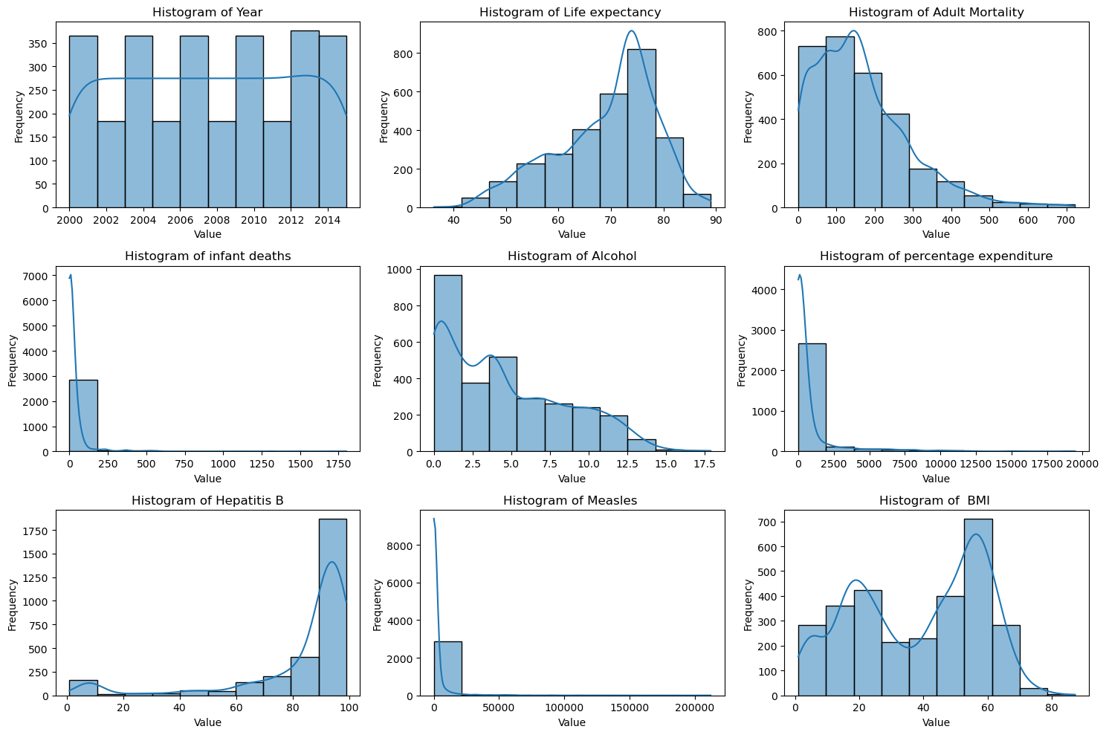
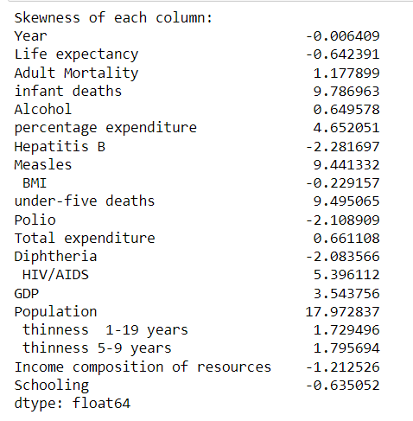
Skewness Of Each Numerical Column

Slide 12
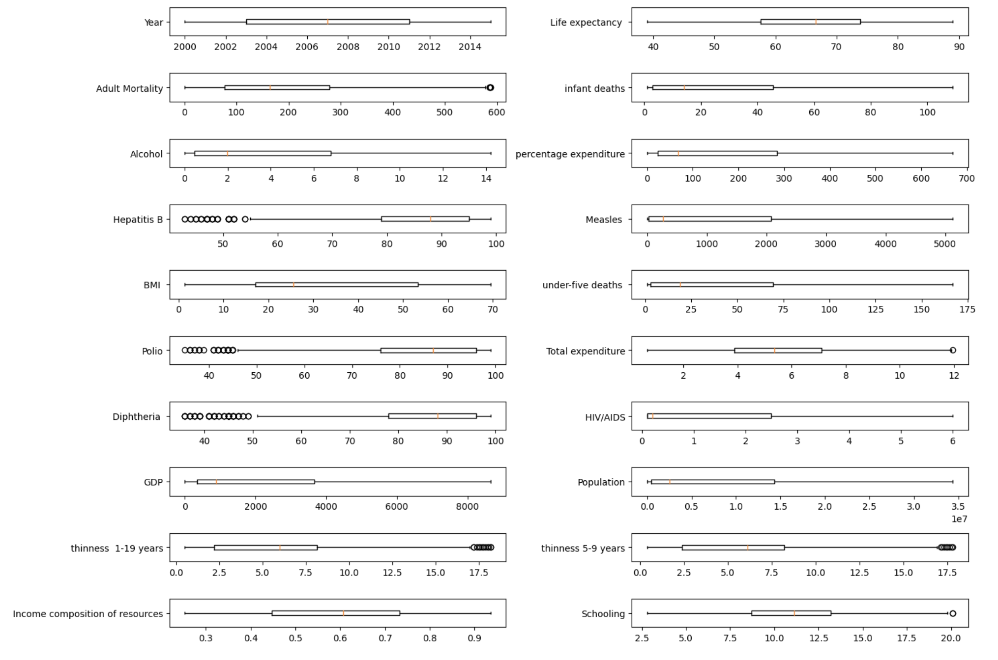
Outliers After Mean Imputation

Slide 13
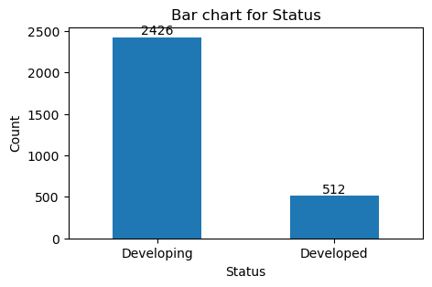
Distribution of Categorical data

Slide 14
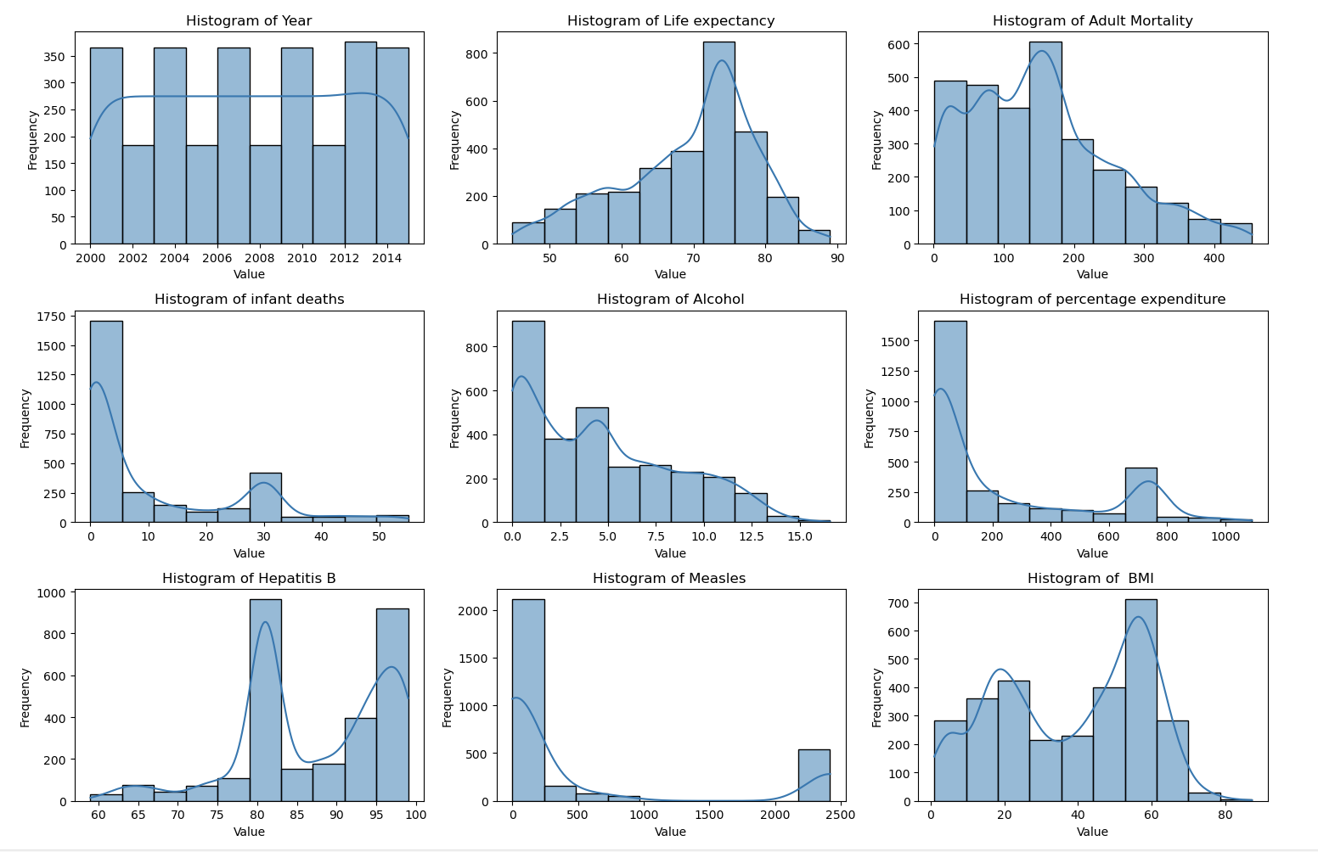
Distribution of Numerical data

Slide 15
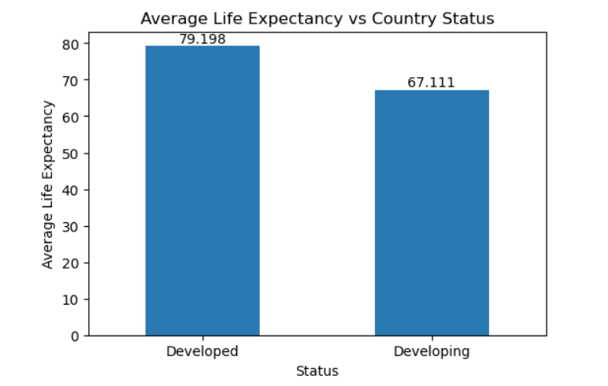
Bivariate Analysis

Slide 16
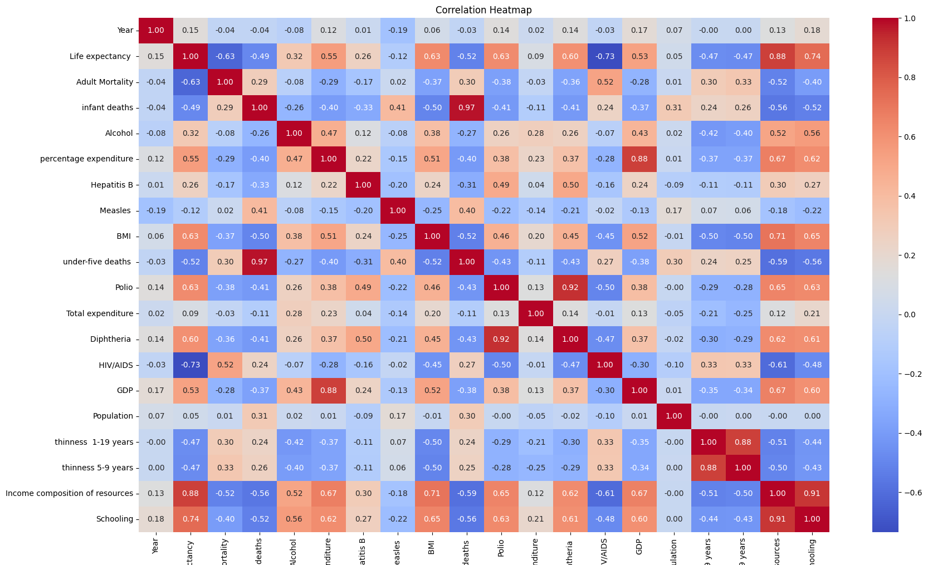
Multivariate Analysis

Slide 17
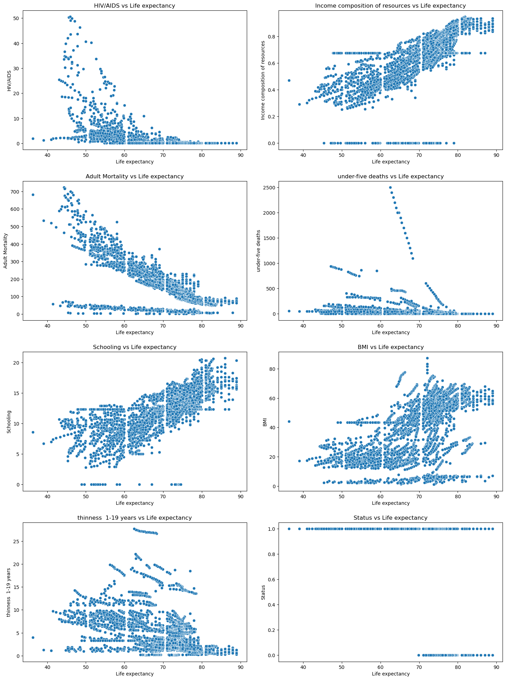
Scatterplot

Slide 18
Visualizations
https://public.tableau.com/views/DATA_230_Project/Story1?:language=en-US&publish=yes&:sid=&:display_count=n&:origin=viz_share_link

Slide 19

Proposed Solution

Slide 20
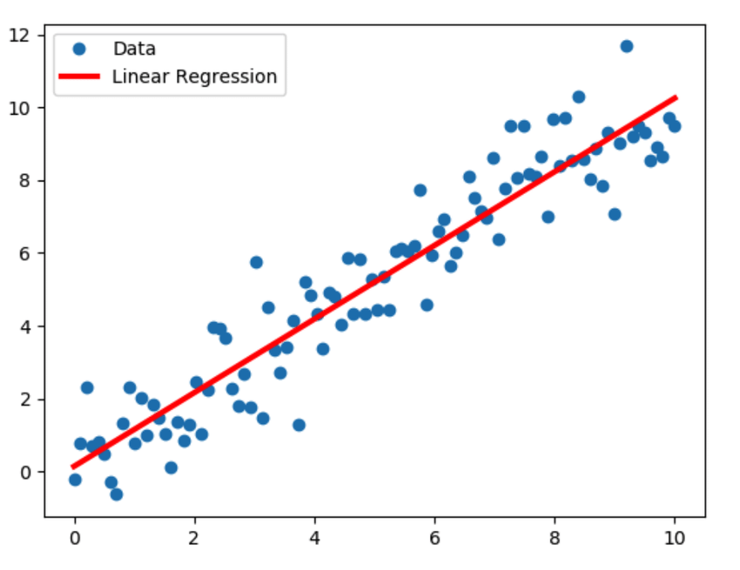
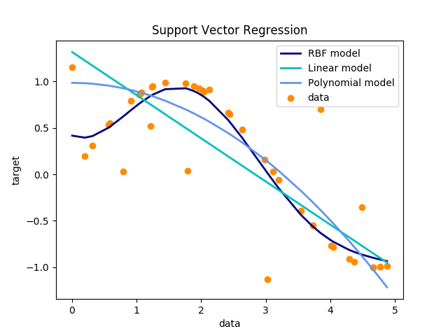
Regression Techniques
Linear Regression
Support Vector Regression

Slide 21
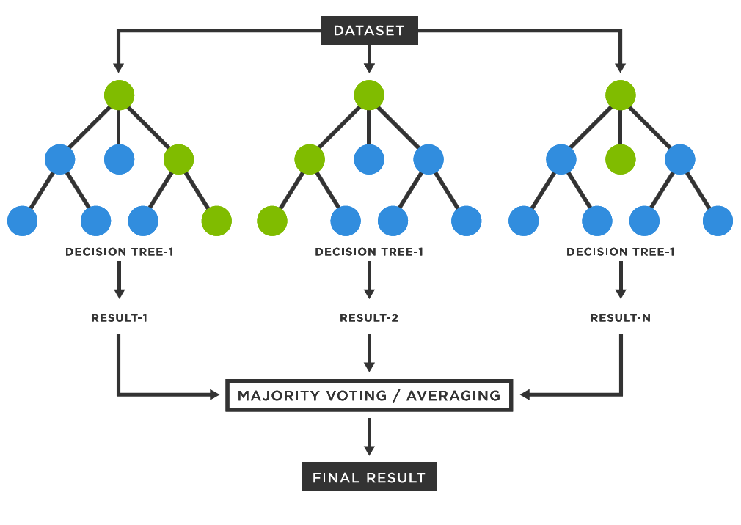
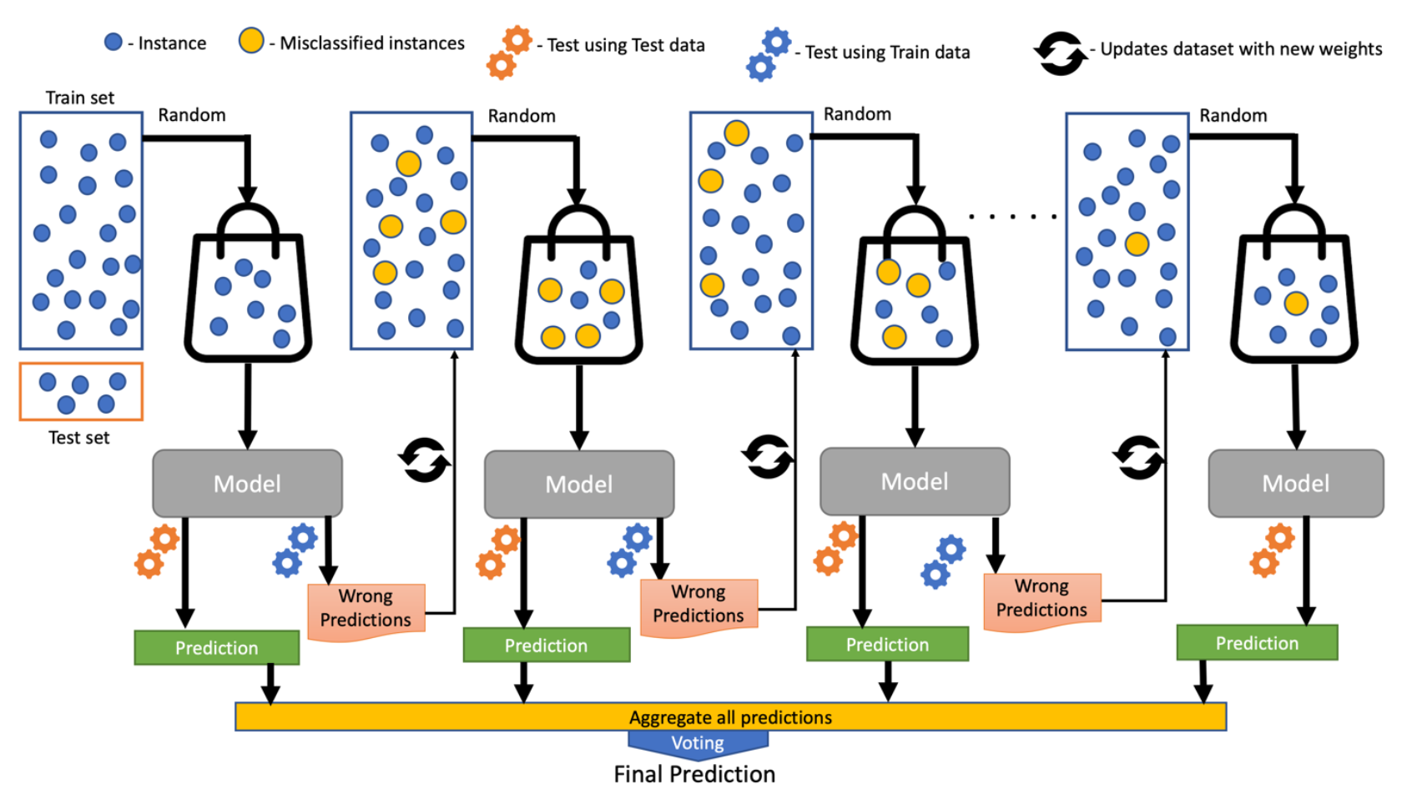
Regression Techniques
Random Forest
Gradient Boosting

Slide 22
Process for ML based Predictions
Model Training
Model
Training Data
Training
Results
Historical Data
Feature Engineering
Validation Data
Validation
Results
Hyperparameter Tuner
Test Data
Prediction
Metrics

Slide 23
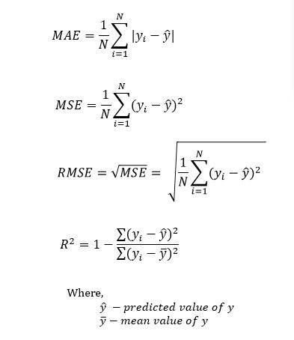
Regression Evaluation Metrics
MAE, MSE and RMSE indicate how much the predicted values are deviating from the actual values
R² indicates the proportion of variance in the dependent variable

Slide 24
Ensemble Prediction
Training Data
Linear Regression
SVR
Random Forest
Gradient Boosting
Prediction 1
Prediction 2
Prediction 3
Prediction 4
Simple Weighted Average Voting
Final Prediction

Slide 25
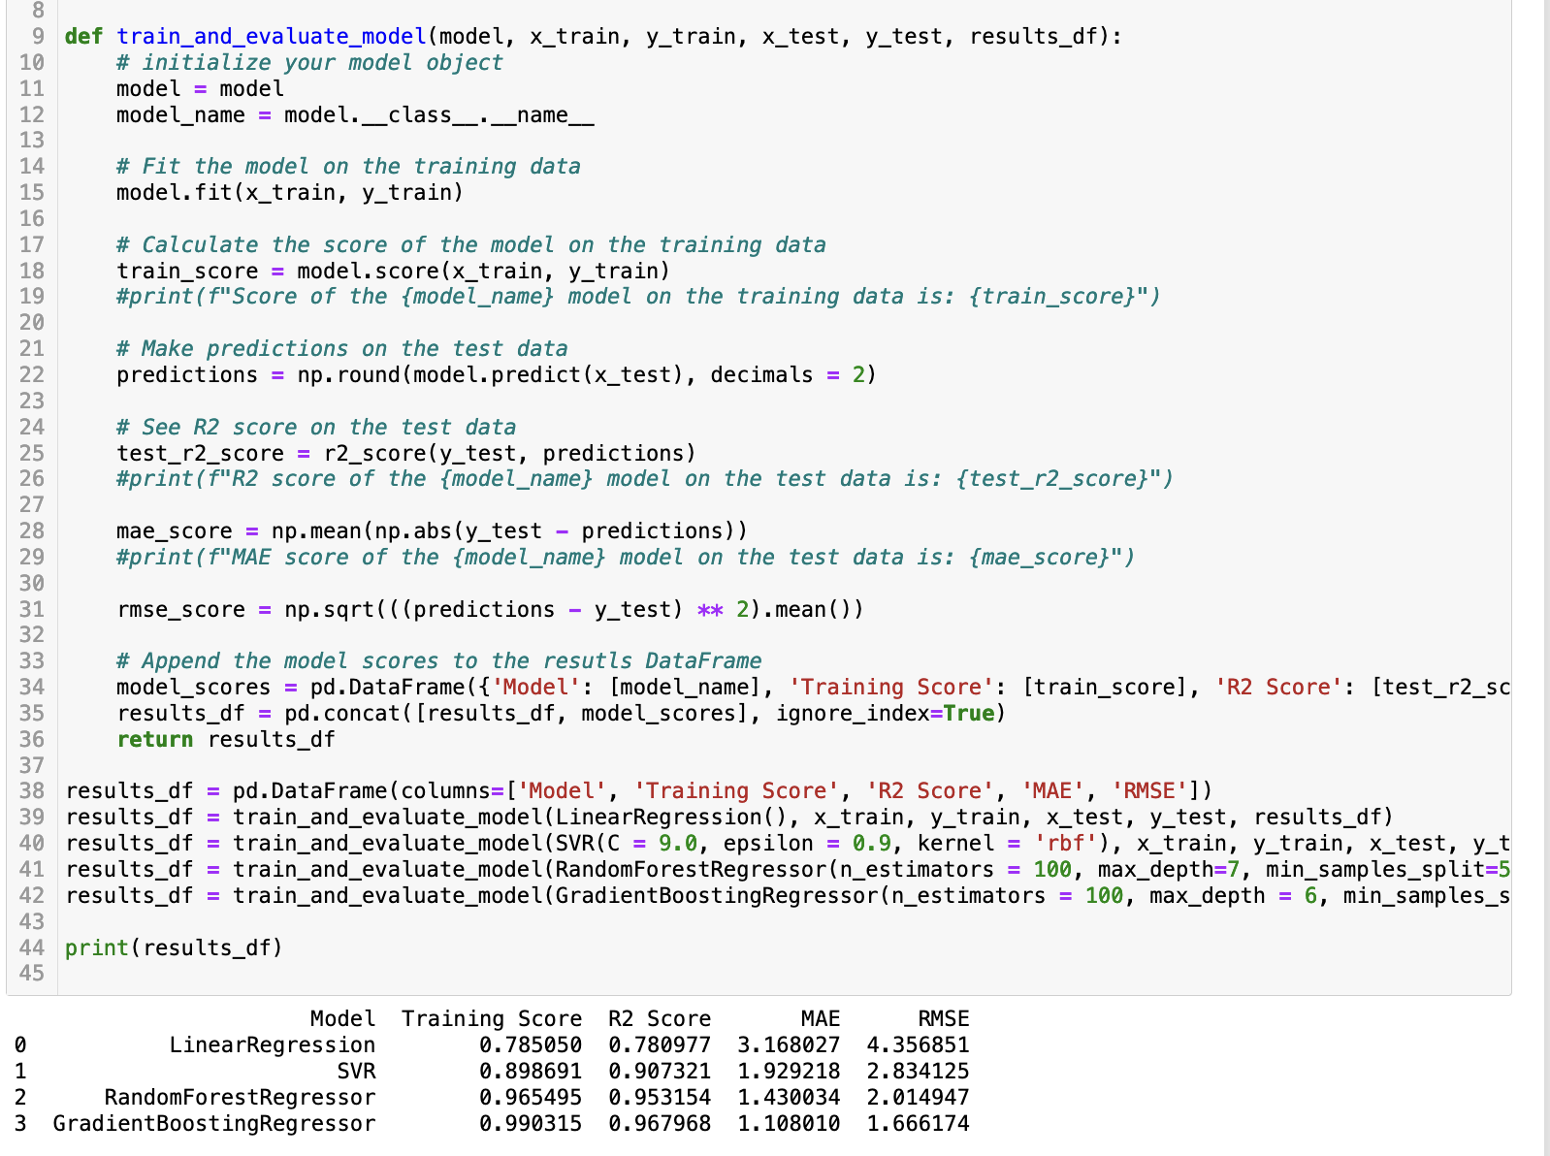
Model Training and Evaluation

Slide 26
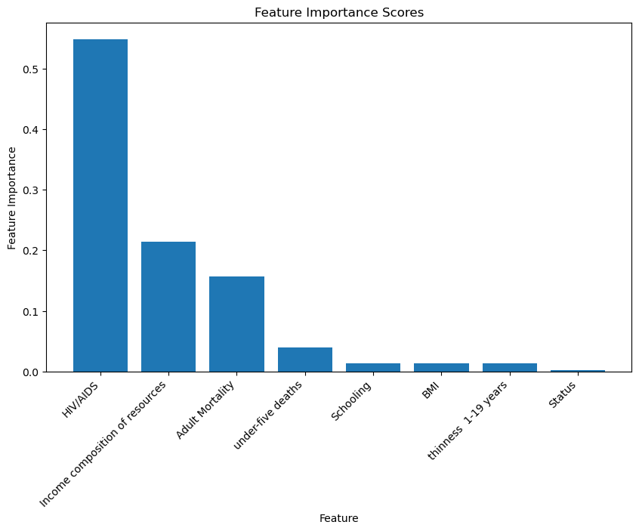
Feature Importance Score

Slide 27
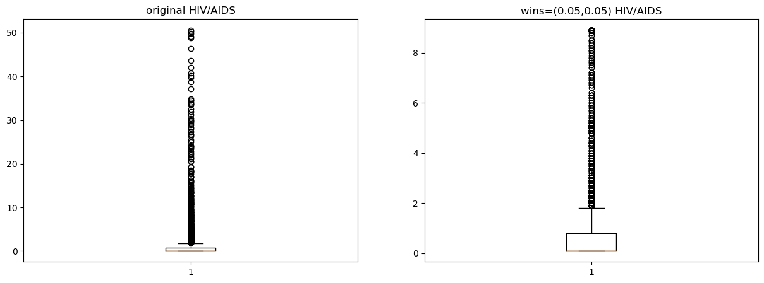
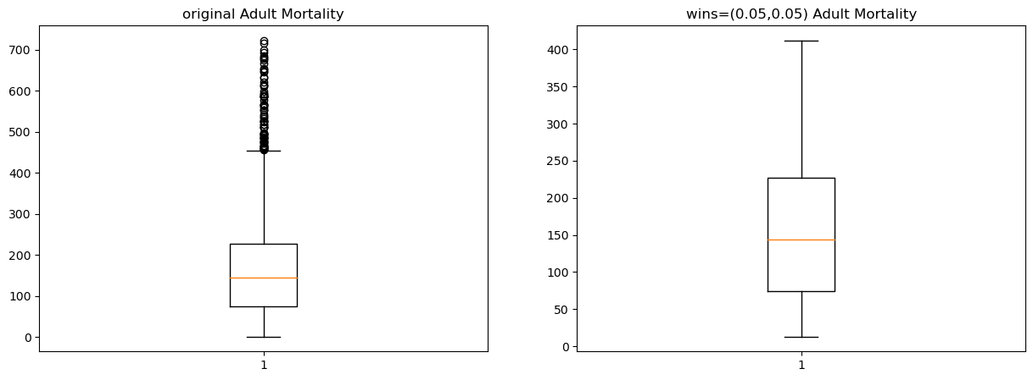
Winsorization

Slide 28
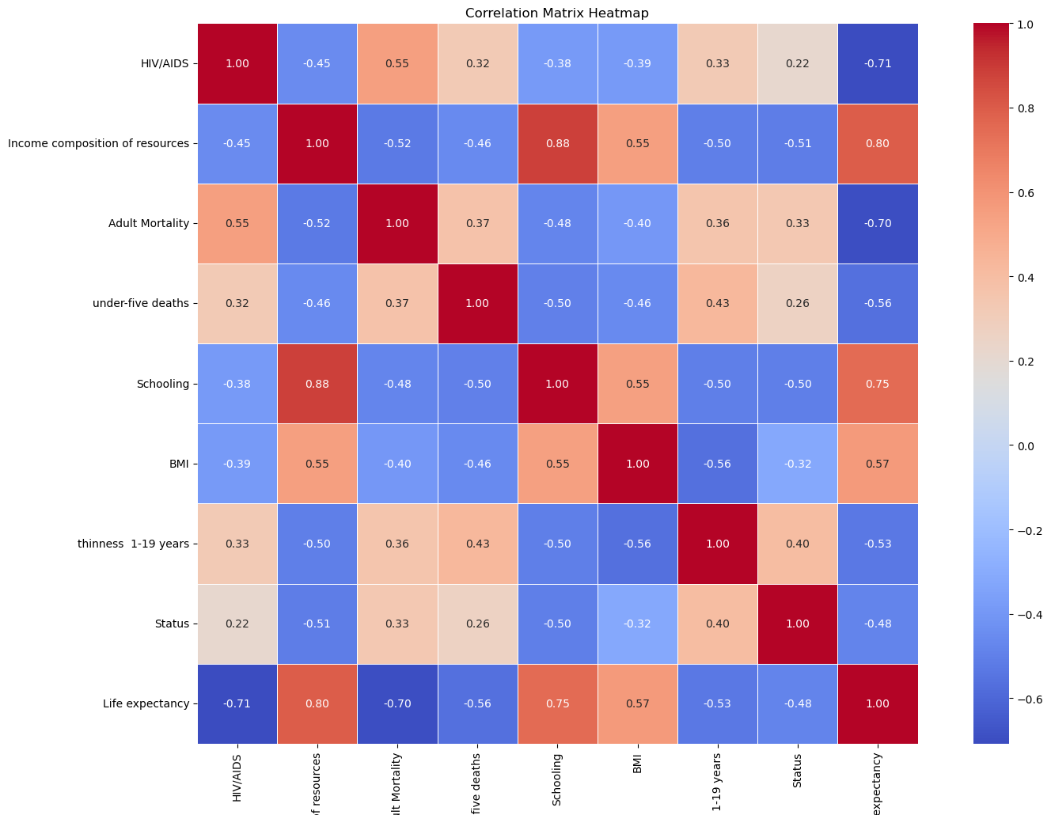
Correlation matrix after winsorization

Slide 29
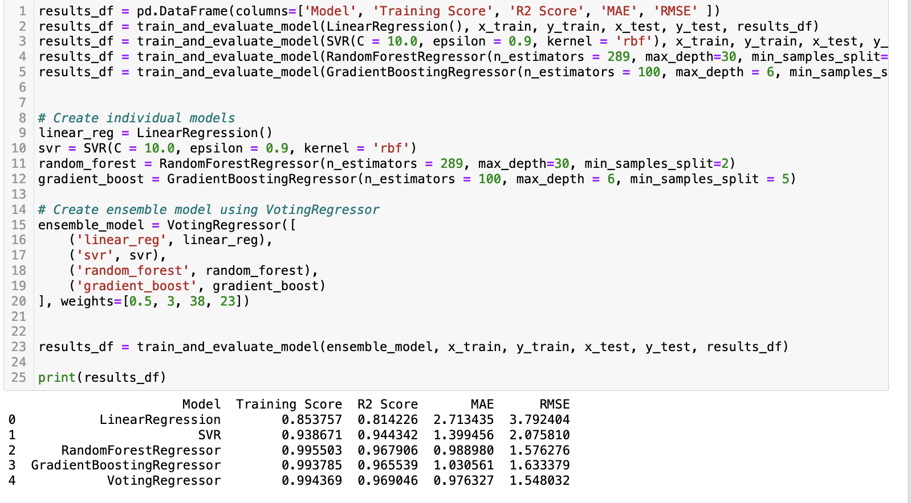
Model Training and Evaluation

Slide 30
Comparison of Metrics
Model | R2 Score Before | R2 Score After | MAE Before | MAE After | RMSE Before | RMSE After
Linear Regression Model | 0.7809 | 0.8142 | 3.1680 | 2.7134 | 4.3568 | 3.7924
SVR | 0.9073 | 0.9443 | 1.9292 | 1.3994 | 2.8341 | 2.0758
Random Forest Regressor | 0.9531 | 0.9679 | 1.4300 | 0.9889 | 2.0149 | 1.5762
Gradient Boosting Regressor | 0.9679 | 0.9655 | 1.1080 | 1.0305 | 1.6661 | 1.6333

Slide 31
Conclusion
From the project we infer that the features like HIV, Income and Adult mortality has more effect on the Life Expectancy.
The scores have improved after preprocessing the data and hyperparameter tuning.
Compared to the individual models the ensemble prediction was more accurate.

